Slide 1

LETOURNEAU UNIVERSITY EETC 3433 ELECTRICAL MACHINERY AND CONTROLS for JLNU Fall Semester 2024 Lesson 8: 20241106 Wed
By Judy WS Wong

Slide 2
Agenda
Before Break
PID control
After Break
Kahoot! game
Writing on the Chocolate Foudue Machine

Slide 3
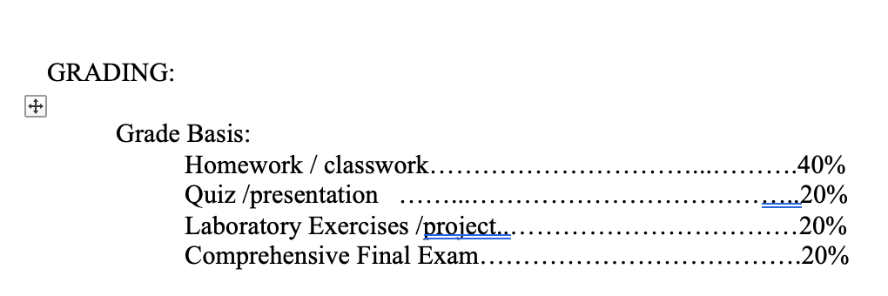
In case that you are aware..

Slide 4
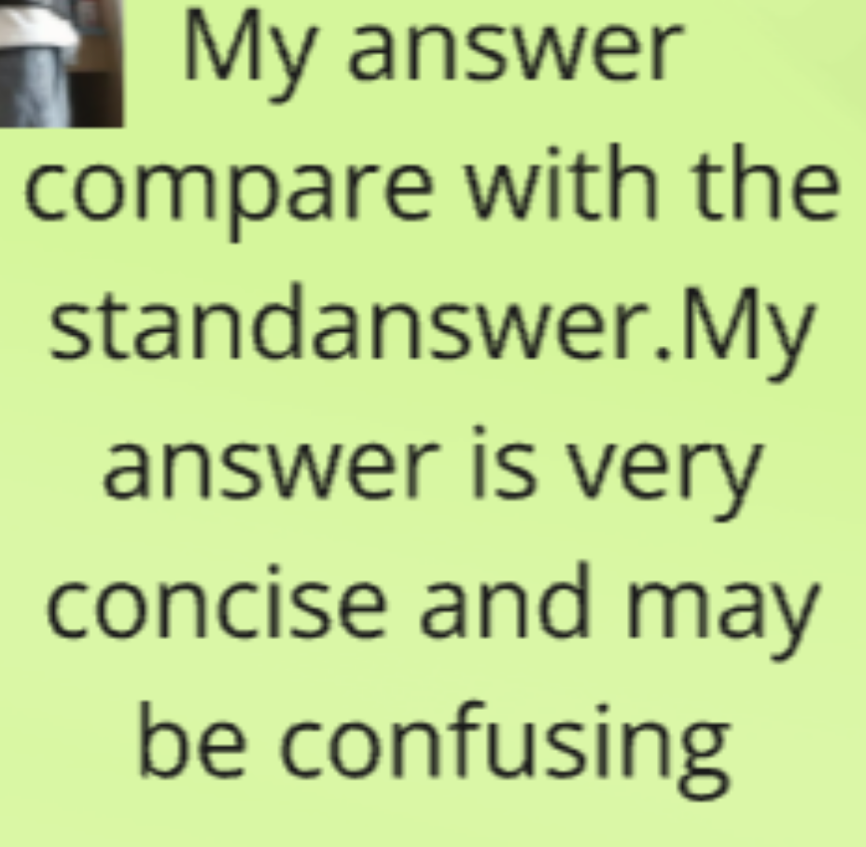
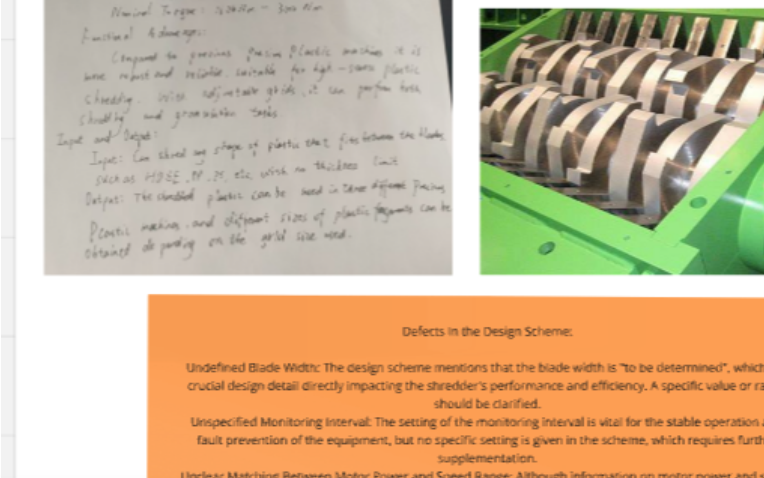
Comments on homework
I can’t read what’s written here… would you please re-capture the screenshot?

Slide 5
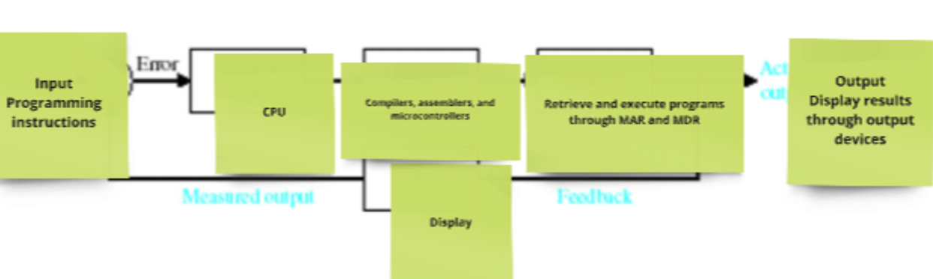
This is a flowchart, not a control system diagram

Slide 6
Back to Syllabus: PID controller
https://www.bilibili.com/video/BV1sVbseGEJz/. (20 min)
https://www.electricaltechnology.org/2015/10/what-is-pid-controller-how-it-works.html
Kahoot – Create a 10 question Kahoot! Based on the above information. No need to create teaching slides as these are all included.
Submit it here: https://classroom.github.com/a/yX5kb2u6

Slide 7
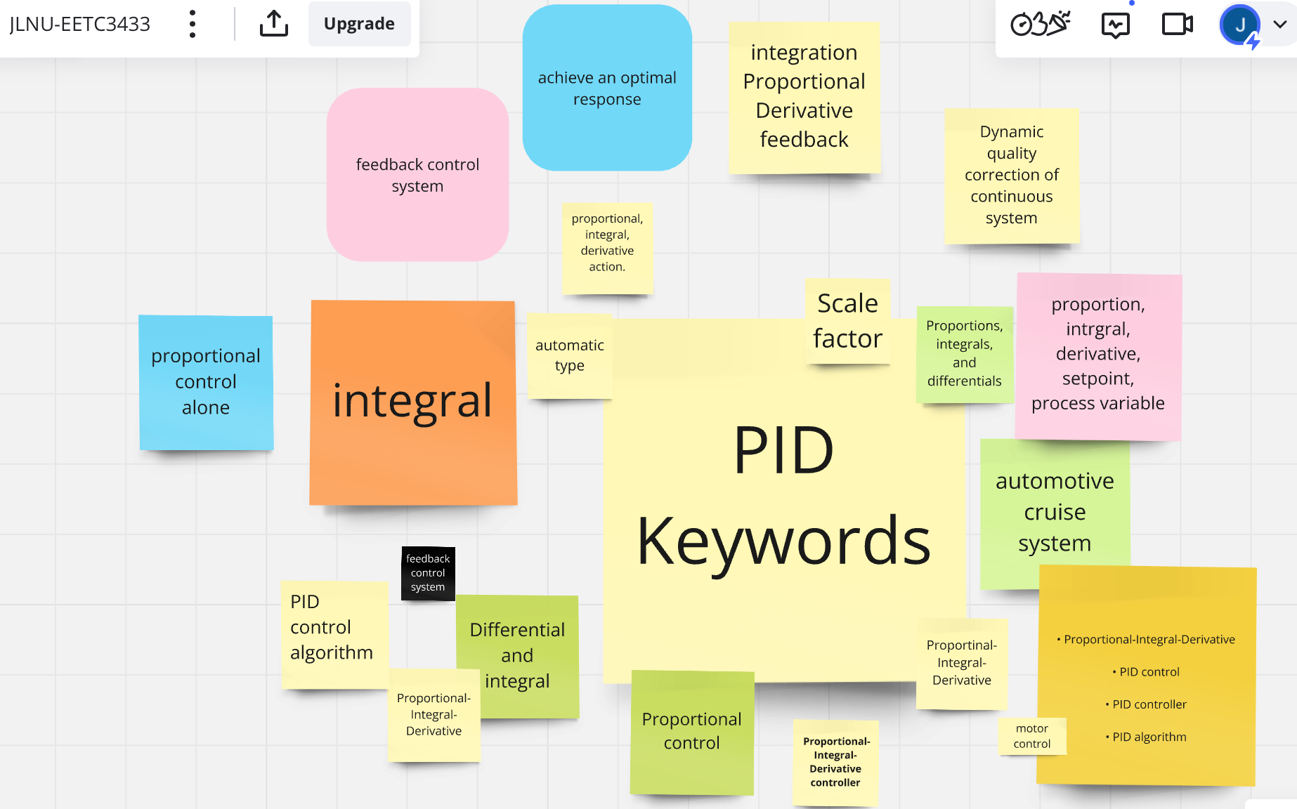

Slide 8
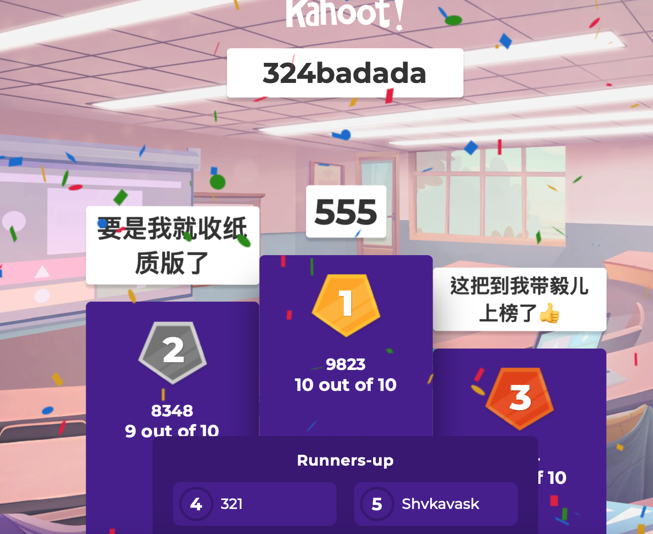
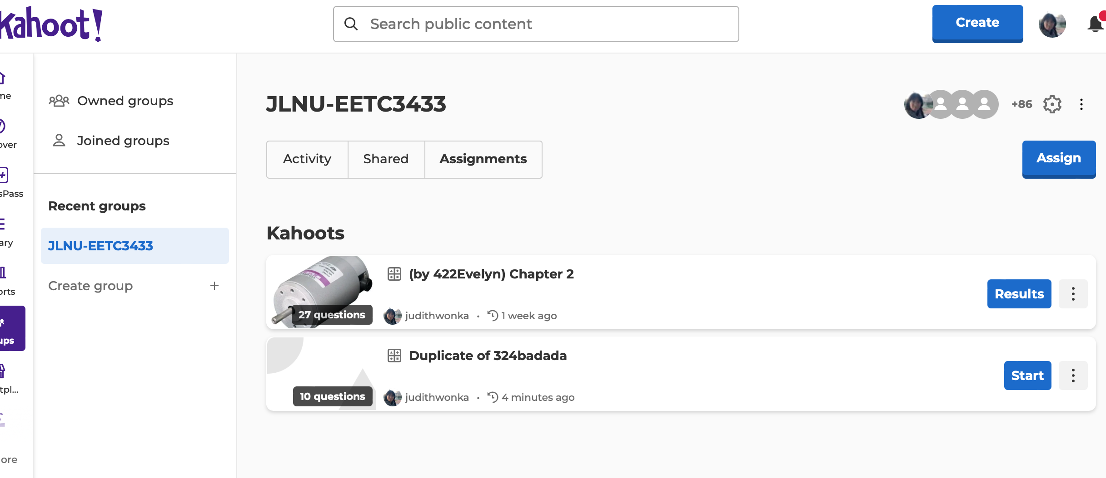
Break then Kahoot Time!
Exercise: do the Kahoot assignment if you haven’t go through it yourself, do until you get them all correct

Slide 9
Homework
1. PID controller, 10 Kahoot Question
https://classroom.github.com/a/yX5kb2u6
Also go through the “assignment” in group to make sure you get all your answers right
2. Make sure you have submitted all other assignments by this Friday
Lesson 1: https://classroom.github.com/a/d7f9rWw_
Lesson 2: https://classroom.github.com/a/cuu4A9dQ
Lesson 3: https://classroom.github.com/a/puh2yRDJ
Lesson 7: https://classroom.github.com/a/J21YRYuh

Slide 10
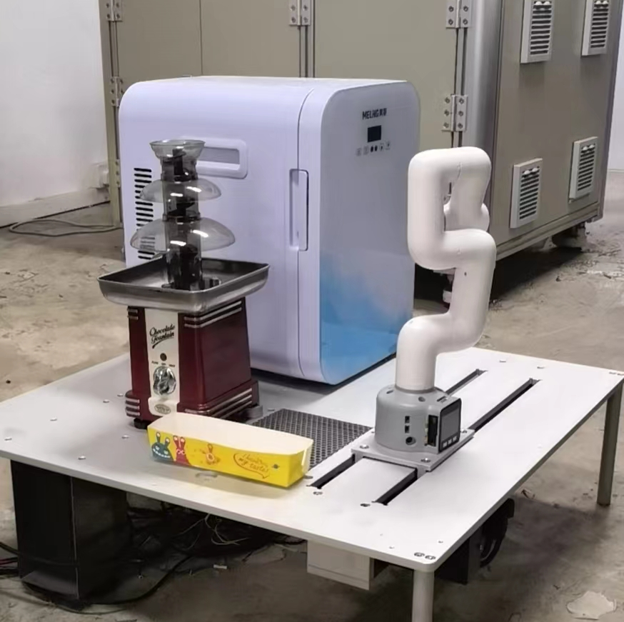
Next exercise
About the Chocolate fountain robot
(We will go back to the waffle machine after this… as that is way too complicated)

